Slide 1
Computer Vision
Active Learning 2
N조
201932431 노성래
202035510 김유현
202239866 김원준
202235084 이수민

Slide 2
Contents
Problem Analysis
Proposal Model
Specification
About DenseNet
Conclusion
Analysis of New Model
Baseline Model vs New Model

Slide 3
Problem Analysis
Weakness of the baseline model(ResNet18)
Parameter Count and Computational Load
Complex Structure
Limitations in Generalization Performance
Limited Representational Power Due to Fewer Layers
Transfer Learning Constraints
Training and Optimization Issues
Recognition of problems in existing research
Limitations of the ResNet18 Model
Overfitting Concerns
Approaches to solve the problems
ResNet50
DenseNet161
GoogleNet

Slide 4
Proposal Model - Specification
 | Baseline Model | Proposal Model
Model | ResNet18 | DenseNet161
Epochs | 10 | 10
Batch_size | 32 | 32
Learning_rate | 0.1 | 0.1

Slide 5
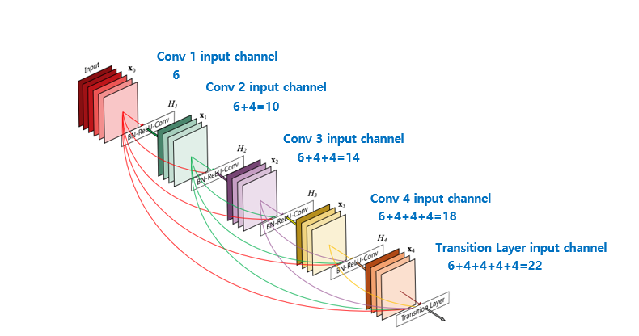
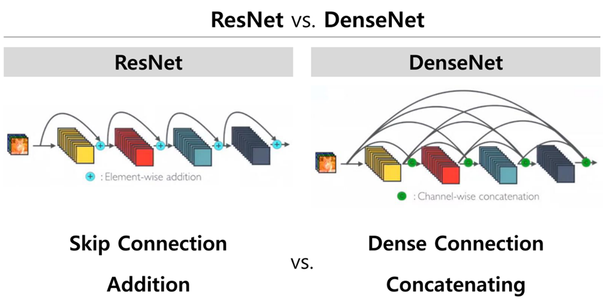
About DenseNet
Definition: Network that uses a densely connected pattern where every layer is connected to every other layer is commonly referred to as a Dense Neural Network
Key Difference:
ResNet uses addition of feature maps via residual connections, where the input is added to the output of the block.
DenseNet uses concatenation of feature maps, where the outputs of all previous layers are concatenated to form the input to the current layer.
ResNet only connects a given layer to its direct predecessor, whereas DenseNet connects each layer to all previous layers within the dense block, allowing for more comprehensive feature reuse.

Slide 6
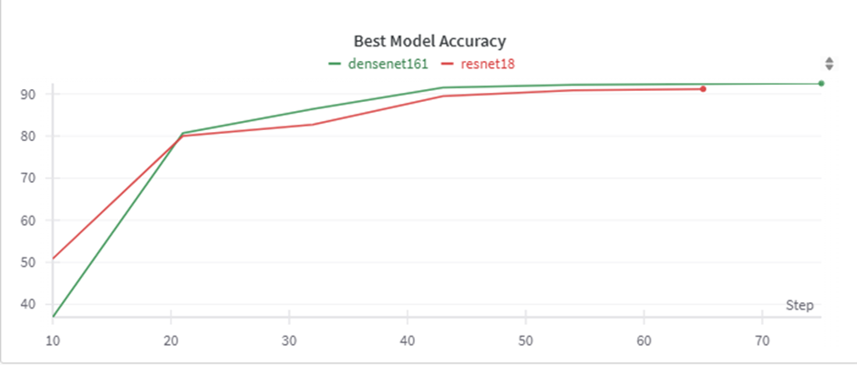
Proposal Model - Analysis
Best Model Accuracy

Slide 7
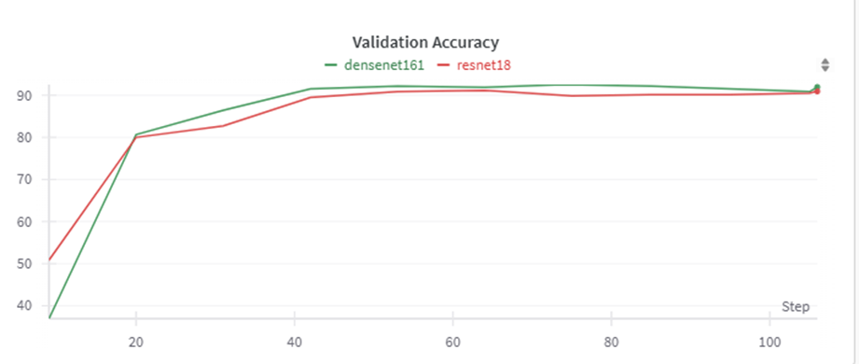
Proposal Model - Analysis
2) Validation Accuracy

Slide 8
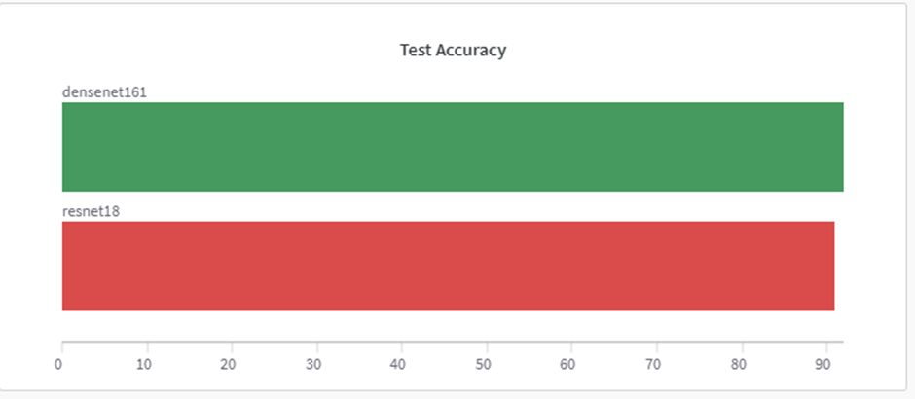
Proposal Model - Analysis
3) Test Accuracy

Slide 9
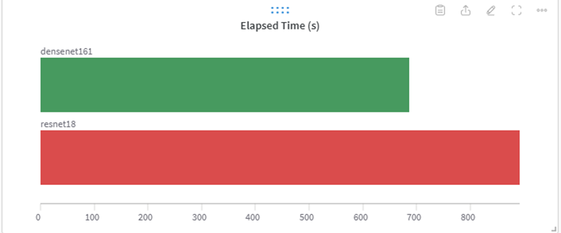
Proposal Model - Analysis
4) Elapsed Time
Proposal Model - Analysis
3) Test Accuracy

Slide 10
Proposal Model
Conclusion
-> Compared to the baseline model, the DenseNet model showed slightly better performance and faster training.
 | ResNet18 | DenseNet161 | Increase Growth /Rate of increase
Best Accuracy | 91.18% | 92.5% | 1.3% Growth
Training Time | 892 sec | 686 sec | 77% Rate
Notes:
Specifically, the baseline model's best accuracy was 91.18%, while the DenseNet model achieved 92.5%, about 1.3% higher.
In terms of training time, DenseNet took 686 seconds, while the baseline model took 892 seconds, demonstrating approximately a 77% improvement in time efficiency.

Slide 11
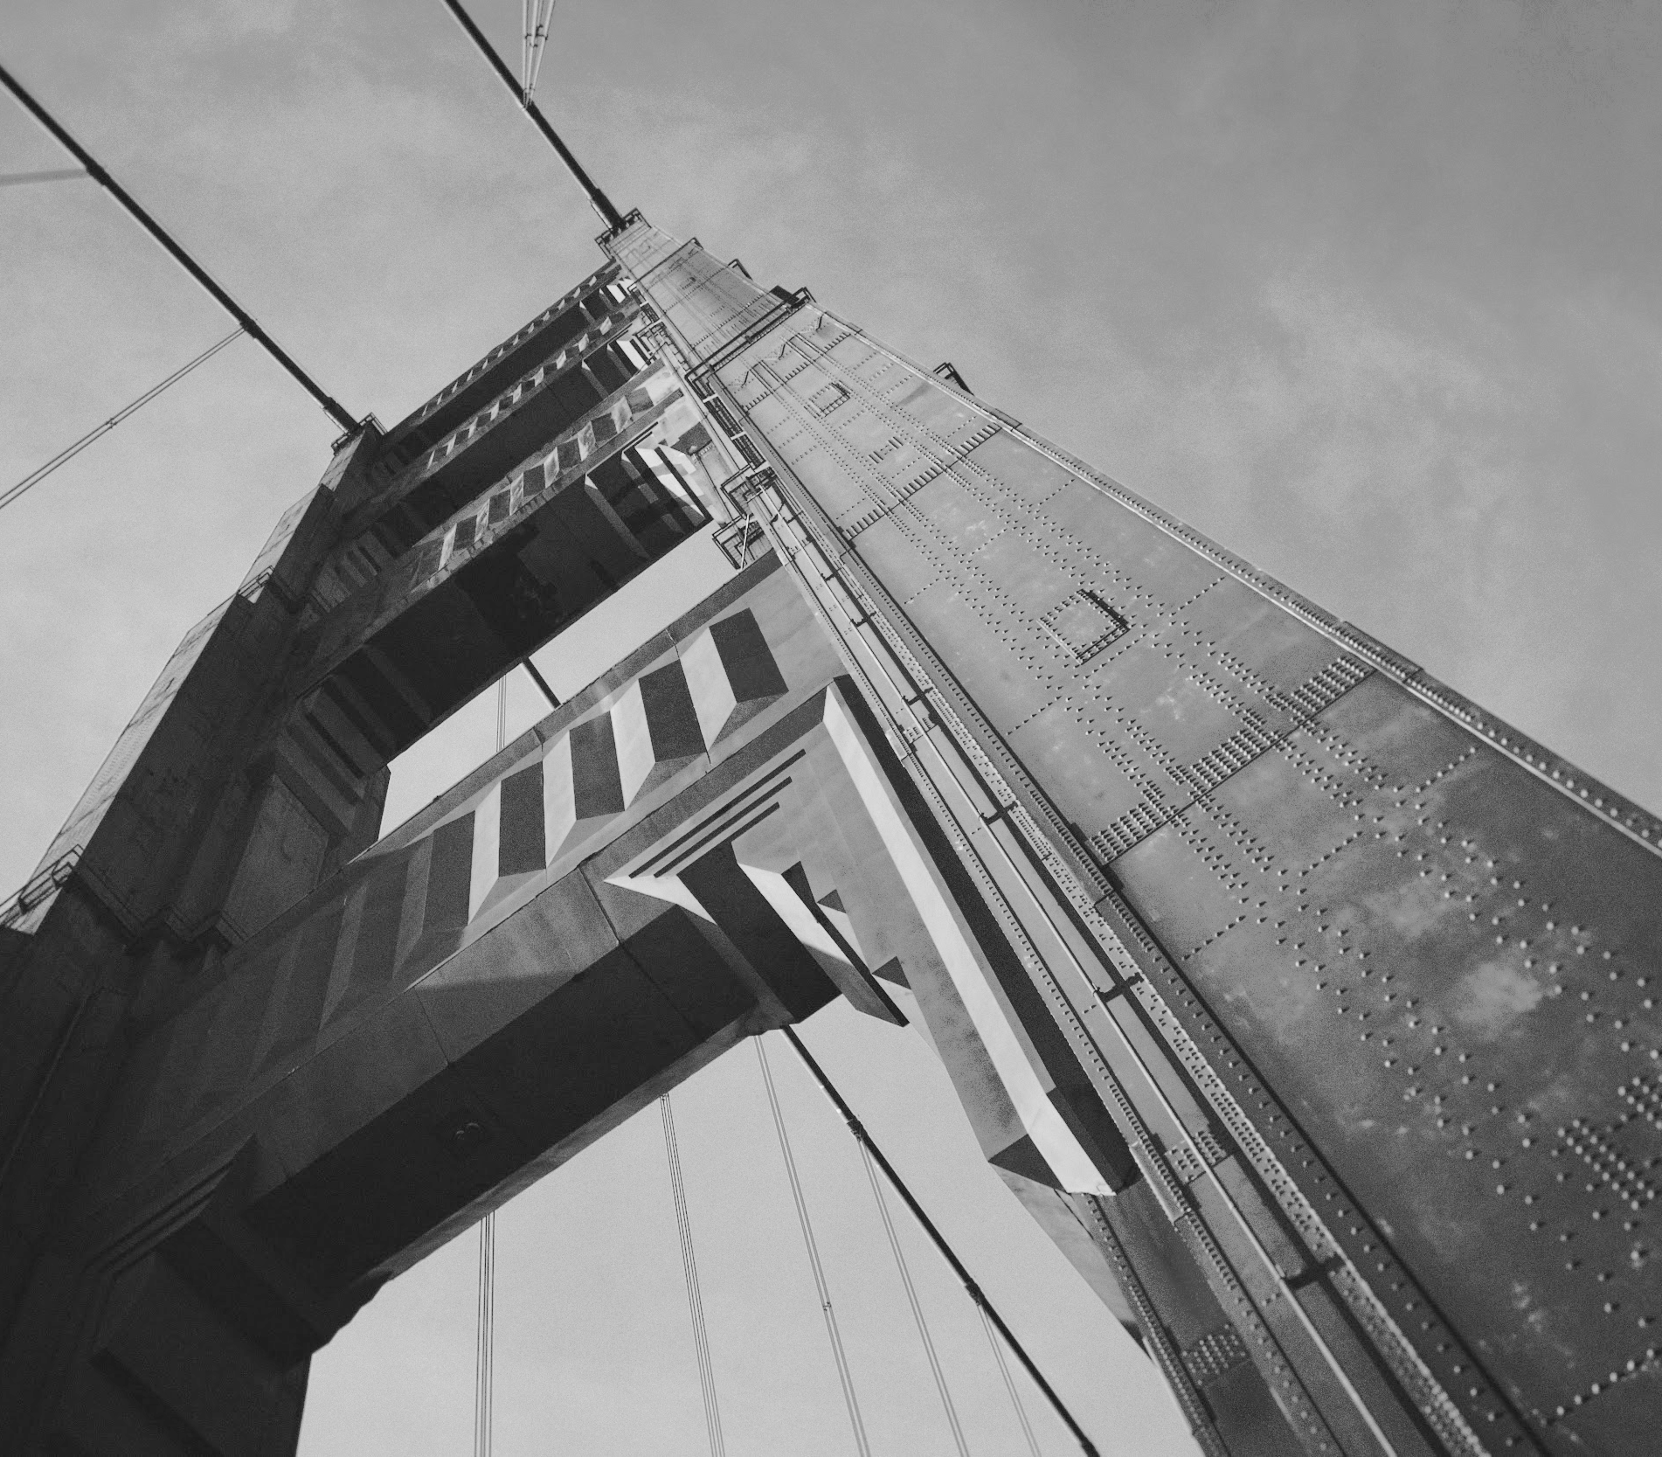
Thank You
Reference
https://gaussian37.github.io/dl-concept-densenet/
https://arxiv.org/pdf/1608.06993
https://deep-learning-study.tistory.com/528
https://beginnerdeveloper-lit.tistory.com/162

